Slide 1
Induction and Recursion
Computer Science, Purdue University
Copyright McGraw Hill, Rosen, Discrete Mathematics and its Applications

Slide 2
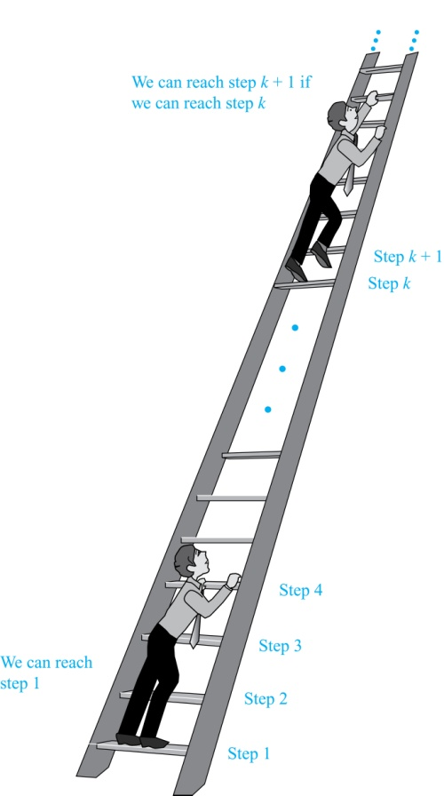
Induction and Recursion
Mathematical Induction
Suppose we have an infinite ladder:
We can reach the first rung of the ladder.
If we can reach a particular rung of the ladder, then we can reach the next rung.
From (1), we can reach the first rung. Then by applying (2), we can reach the second rung. Applying (2) again, the third rung. And so on. We can apply (2) any number of times to reach any particular rung, no matter how high up.
This example motivates proof by mathematical induction.
Computer Science, Purdue University

Slide 3
Induction and Recursion
Principle of Mathematical Induction
Principle of Mathematical Induction: To prove that P(n) is true for all positive integers n, we complete these steps:
Basis Step: Show that P(1) is true.
Inductive Step: Show that P(k) → P(k + 1) is true for all positive integers k.
To complete the inductive step, assuming the inductive hypothesis that P(k) holds for an arbitrary integer k, show that must P(k + 1) be true.
Climbing an Infinite Ladder Example:
BASIS STEP: By (1), we can reach rung 1.
INDUCTIVE STEP: Assume the inductive hypothesis that we can reach rung k. Then by (2), we can reach rung k + 1.
Hence, P(k) → P(k + 1) is true for all positive integers k. We can reach every rung on the ladder.
Computer Science, Purdue University

Slide 4
Induction and Recursion
Principle of Mathematical Induction
Mathematical induction can be expressed as the rule of inference
where the domain is the set of positive integers.
In a proof by mathematical induction, we don’t assume that P(k) is true for all positive integers! We show that if we assume that P(k) is true, then P(k + 1) must also be true.
Proofs by mathematical induction do not always start at the integer 1. In such a case, the basis step begins at a starting point b where b is an integer. We will see examples of this soon.
(P(1) ∧ ∀k (P(k) → P(k + 1))) → ∀n P(n),
Computer Science, Purdue University

Slide 5
Induction and Recursion
Validity of Mathematical Induction
Mathematical induction is valid because of the well ordering property, which states that every nonempty subset of the set of positive integers has a least element. Here is the proof:
Suppose that P(1) holds and P(k) → P(k + 1) is true for all positive integers k.
Assume there is at least one positive integer n for which P(n) is false. Then the set S of positive integers for which P(n) is false is nonempty.
By the well-ordering property, S has a least element, say m.
We know that m can not be 1 since P(1) holds.
Since m is positive and greater than 1, m − 1 must be a positive integer. Since m − 1 < m, it is not in S, so P(m − 1) must be true.
But then, since the conditional P(k) → P(k + 1) for every positive integer k holds, P(m) must also be true. This contradicts P(m) being false.
Hence, P(n) must be true for every positive integer n.
Computer Science, Purdue University

Slide 6
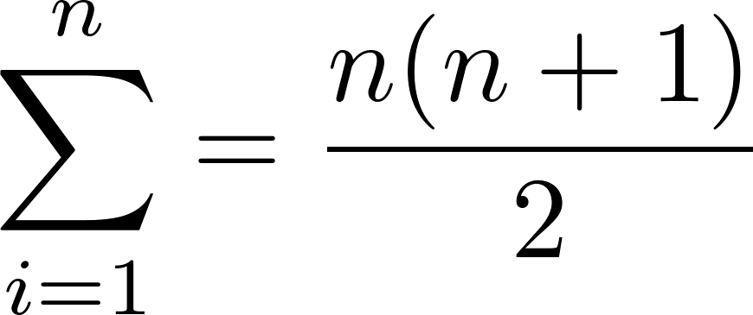
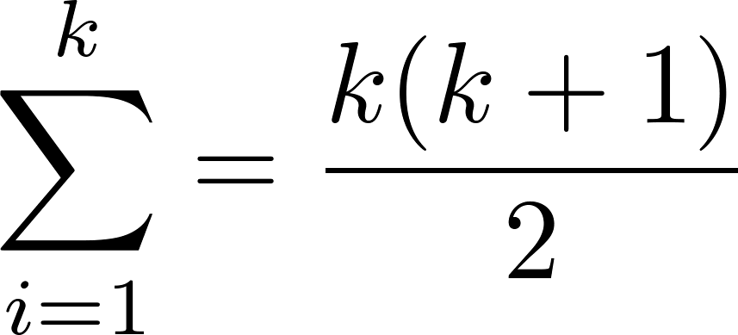
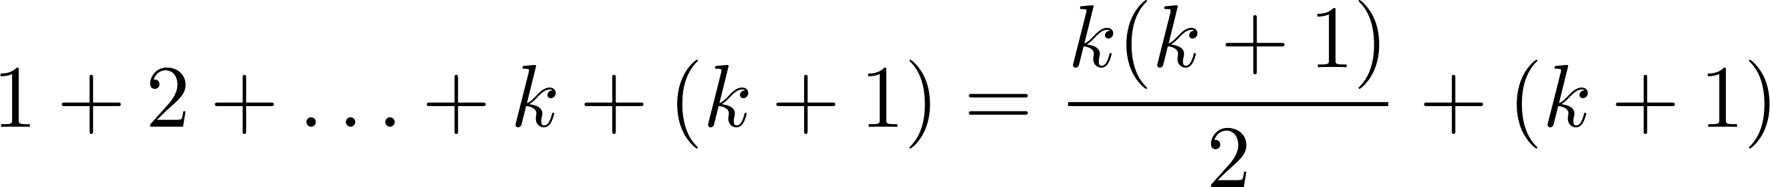
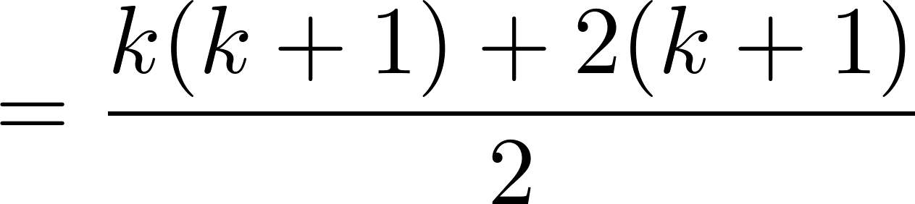
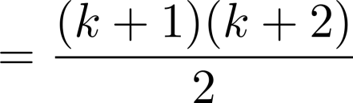
Induction and Recursion
Mathematical Induction: Example
Note: Once we have this conjecture, mathematical induction can be used to prove it correct.
Example: Show that:
Solution:
BASIS STEP: P(1) is true since 1(1 + 1)/2 = 1.
INDUCTIVE STEP: Assume true for P(k).
The inductive hypothesis is
Under this assumption,
i
i
Computer Science, Purdue University

Slide 7
Induction and Recursion
Conjecturing and Proving a Formula
Example: Conjecture and prove correct a formula for the sum of the first n positive odd integers. Then prove your conjecture.
Solution: We have: 1= 1, 1 + 3 = 4, 1 + 3 + 5 = 9, 1 + 3 + 5 + 7 = 16, 1 + 3 + 5 + 7 + 9 = 25.
We can conjecture that the sum of the first n positive odd integers is n²,
We prove the conjecture using mathematical induction.
BASIS STEP: P(1) is true since 1² = 1.
INDUCTIVE STEP: P(k) → P(k + 1) for every positive integer k.
Assume the inductive hypothesis holds and then show that P(k + 1) holds has well.
1 + 3 + 5 + ∙∙∙+ (2n − 1) + (2n + 1) =n² .
Inductive Hypothesis: 1 + 3 + 5 + ∙∙∙+ (2k − 1) =k²
Computer Science, Purdue University

Slide 8
Induction and Recursion
Conjecturing and Proving a Formula
So, assuming P(k), it follows that:
Hence, we have shown that P(k + 1) follows from P(k). Therefore the sum of the first n positive odd integers is n².
1 + 3 + 5 + ∙∙∙+ (2k − 1) + (2k + 1) =[1 + 3 + 5 + ∙∙∙+ (2k − 1)] + (2k + 1)
= k² + (2k + 1) (by the inductive hypothesis)
= k² + 2k + 1
= (k + 1) ²
Computer Science, Purdue University

Slide 9
Thank You

